Slide 1
Update Xenxible Project Device Identifier
Syaziyah

Slide 2
UDPATE 10/07/2026

Slide 3
Full flowchart

Slide 4
PREDICTION MODEL
UNKNOWN
KNOWN SECTION & CLUSTER
CLUSTER (Logic)
Equipment Type, Section
= Assign by the User
Cluster
= Logic (within same section)
FULL
VACANT

Slide 5
PREDICTION MODEL
Approach 1
UNKNOWN
KNOWN SECTION & CLUSTER
CLUSTER (Logic)
Equipment Type, Section
= Assign by the User
Cluster
= Logic (within same section)
FULL
VACANT

Slide 6
PREDICTION MODEL
Approach 2
UNKNOWN
KNOWN SECTION & CLUSTER
CLUSTER (Logic)
Equipment Type, Section
= Assign by the User
Cluster
= Logic (within same section)
FULL
VACANT

Slide 7
Approach 2
PREDICTION
LOGIC
STAGE 1
Highest Percentage fill up the Cluster
CLUSTER = FULL
CLUSTER = VACANT
STAGE 3
Conflict Case
STAGE 2
Kick and replace mechanism
STAGE 4
Solve Conflict Case

Slide 8
Approach 1

Slide 9
PREDICTION MODEL
Approach 1
UNKNOWN
KNOWN SECTION & CLUSTER
CLUSTER (Logic)
Equipment Type, Section
= Assign by the User
Cluster
= Logic (within same section)
FULL
VACANT

Slide 10
Approach 10/07/2026:
Run prediction model
Logic sort the model into section and cluster based on the prediction result
Left the UNKNOWN cluster
UNKNOWN cluster
-Check the top 3 highest percentage
-Load the top 3 cluster obtain from the highest percentage
-Match the pattern algorithm
-Is the equipment exist in the cluster algorithm reference? Yes/No
-NO = EXCLUDE THE CLUSTER
-YES = Proceed with the selection.
-If there is more than 1 similar device type across cluster, which cluster should choose? = choose the cluster in which no Device Type inside.

Slide 11
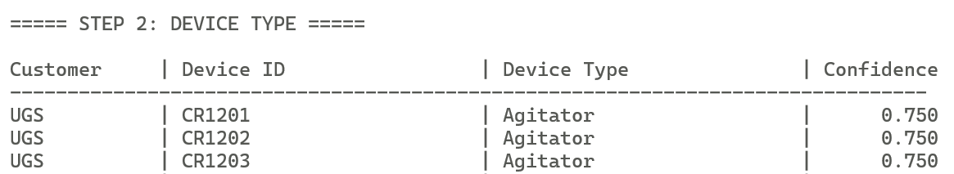
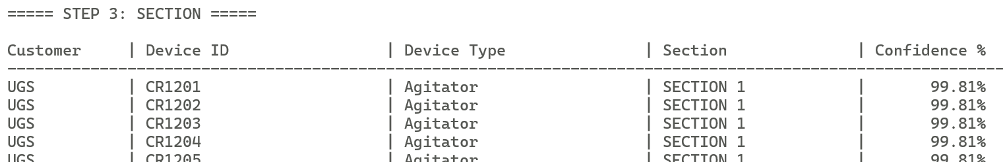
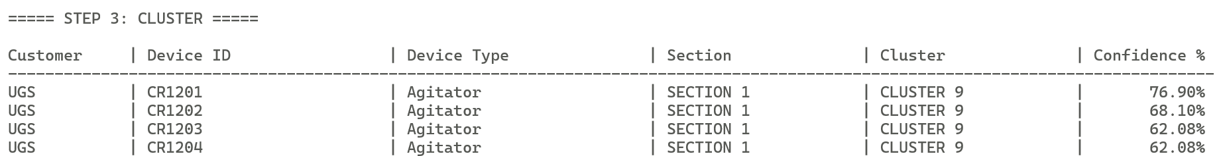
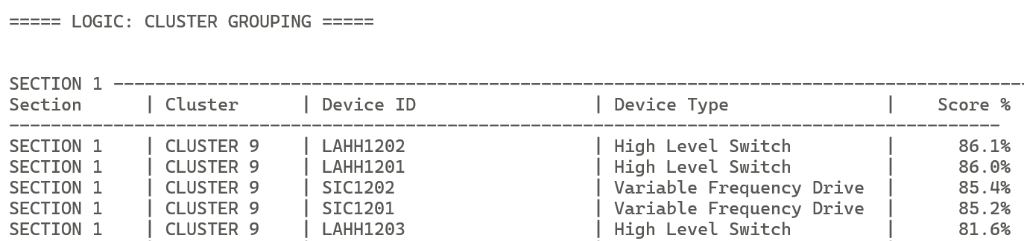
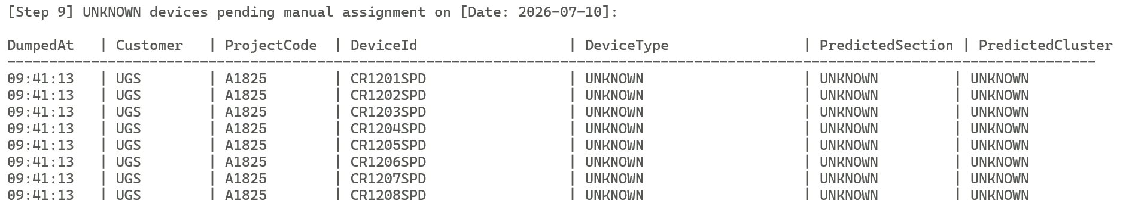
DEVICE TYPE
DEVICE SECTION
DEVICE CLUSTER
SECTION CLUSTER
GROUPING
UNKNOWN

Slide 12
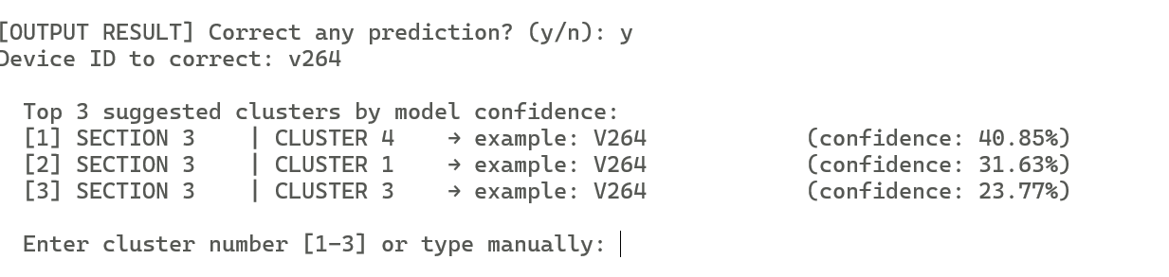
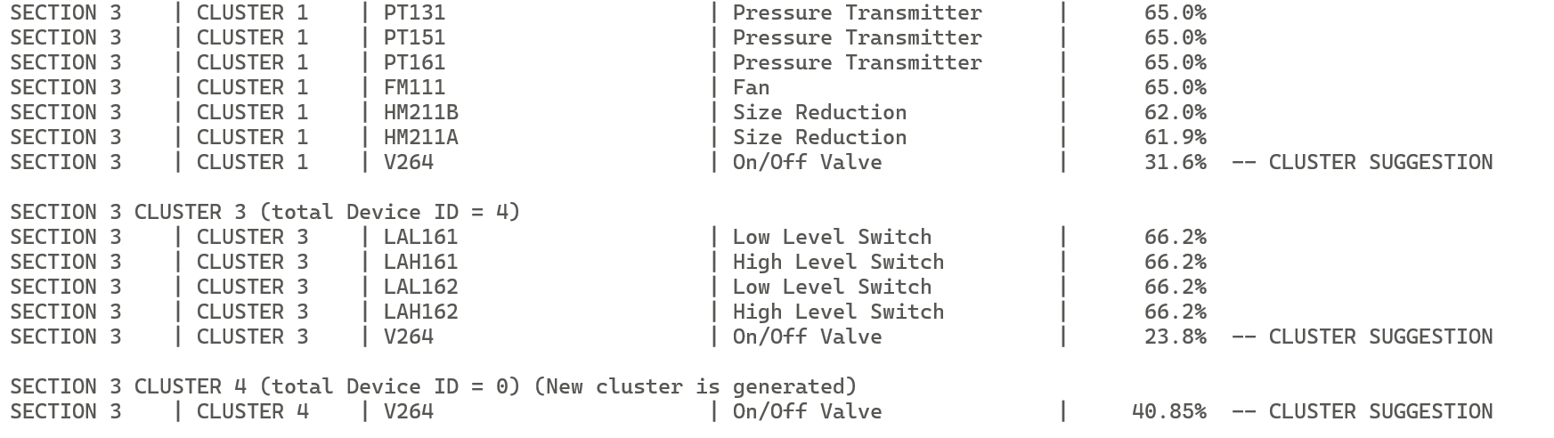
UNKNOWN
ENTER THE DEVICE ID
with UNKNOWN CLUSTER
LOGIC suggest
the CLUSTER location

Slide 13
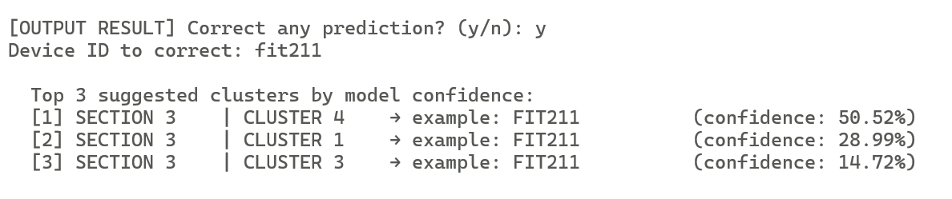
GENERATED ON 14/07/2026
EXAMPLE
FIT211 – SECTION3 CLUSTER UNKNOWN

Slide 14
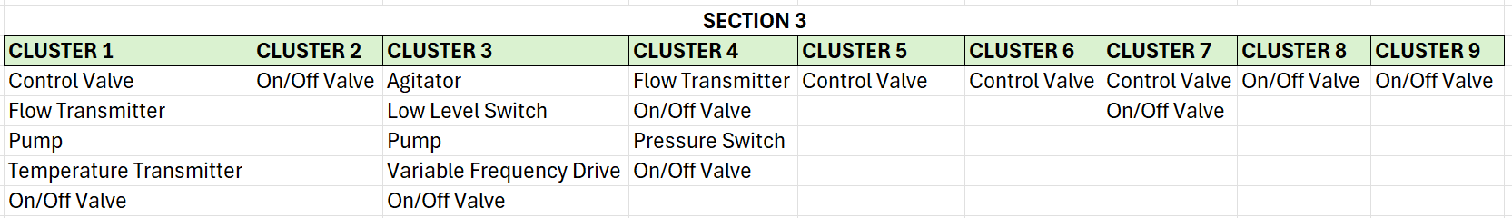
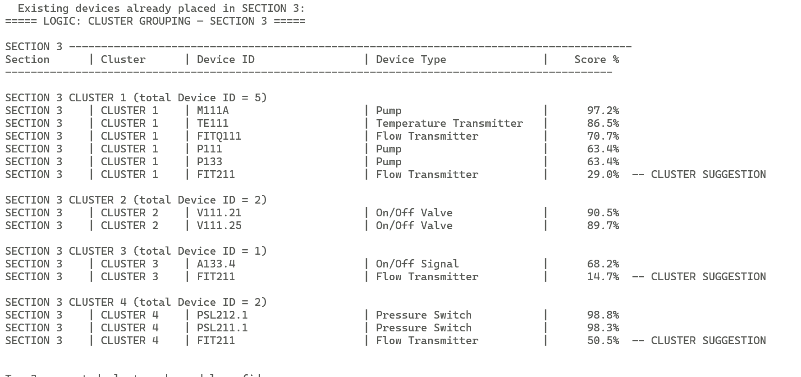
GENERATED ON 14/07/2026
FIT211 – SECTION3 CLUSTER?

Slide 15
Approach 2

Slide 16
LOGIC ALGORITHM
[16/7/2026]

Slide 17
PREDICTION MODEL
Approach 2
UNKNOWN
KNOWN SECTION & CLUSTER
CLUSTER
Equipment Type, Section
= Assign by the User
Cluster
= Logic (within same section)
FULL
VACANT

Slide 18
PREDICTION
LOGIC
STAGE 1
Highest Percentage fill up the Cluster
CLUSTER = FULL
CLUSTER = VACANT
STAGE 3
Conflict Case
STAGE 2
Kick and replace mechanism
STAGE 4
Solve Conflict Case

Slide 19
Current Approach :
Choose 1 customer = OILTEK
Choose 1 section from OILTEK = SECTION 2
Extract the pattern for all cluster at section 2
Create the specific value device cluster for section 2 (N=100)
Introduce the pattern specific cluster into LOGIC
Run the list of Device ID from the model prediction
Logic assign the device id based on the Pattern LOGIC
Detect the cluster = Full or Vacant
Kick and replace Device ID

Slide 20
Section 2 OILTEK (REFERENCE, N=100)
CLUSTER 1
CLUSTER 2
CLUSTER 3
CLUSTER 4
Fan | 4
On/Off Valve | 6
High Level Switch | 6
Low Level Switch | 4
Control Valve | 4
Level Transmitter | 2
Pump | 5
Pressure Switch | 3
Pressure Transmitter | 2
Vibrator | 4
TOTAL | 40
On/Off Valve | 5
Control Valve | 5
TOTAL | 10
On/Off Valve | 4
TOTAL | 4
On/Off Valve | 6
TOTAL | 6
CLUSTER 5
CLUSTER 6
CLUSTER 7
CLUSTER 8
Pump | 4
Heater | 2
Temperature Transmitter | 3
Low Level Switch | 4
TOTAL | 13
Control Valve | 7
On/Off Valve | 7
TOTAL | 14
On/Off Valve | 6
TOTAL | 6
Control Valve | 7
TOTAL | 7

Slide 21
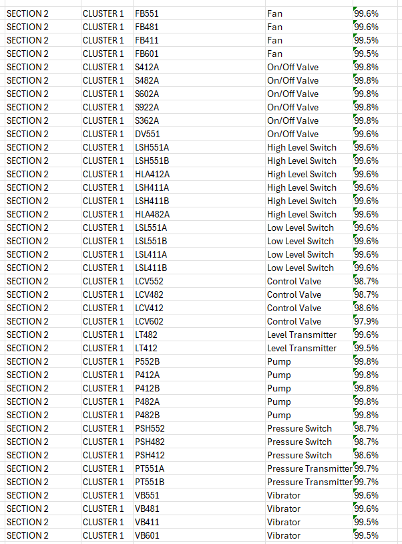
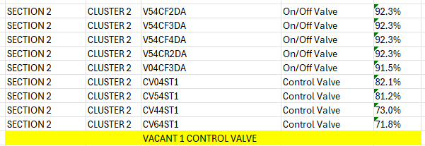

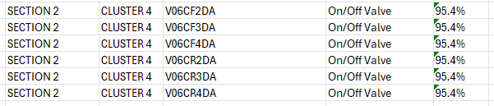
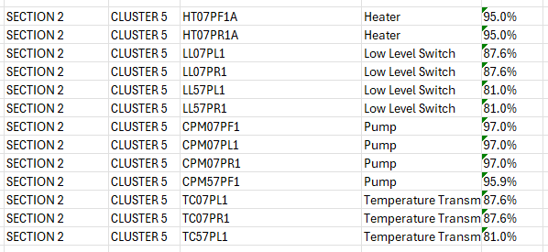
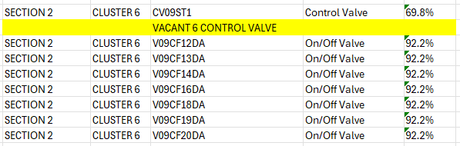
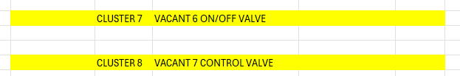
Section 2 OILTEK – EXAMPLE CASE
CLUSTER 1
CLUSTER 2
CLUSTER 3
CLUSTER 4
TOTAL | 9/10
VACANT | 1
TOTAL | 40/40
TOTAL | 4/4
TOTAL | 6/6
CLUSTER 5
CLUSTER 6
CLUSTER 7
CLUSTER 8
TOTAL | 8/14
VACANT | 6
TOTAL | 0/6
VACANT | 6
TOTAL | 0/7
VACANT | 7
TOTAL | 13/13

Slide 22
STAGE 1
Highest Percentage fill up the Cluster
FULL
VACANT (Cluster)
New Device ID coming
= compare the percentage
= kick and replace
= the highest percentage win.
So the loser will go?
Floating device ID fill up the vacant
= pick the highest percentage on the respective reference
What if still vacant?
CLUSTER 1
CLUSTER 1
CLUSTER 5
CLUSTER 7
Control Valve | 4
Fan | 4
High Level Switch | 6
Level Transmitter | 2
Low Level Switch | 4
On/Off Valve | 6
Pressure Switch | 3
Pressure Transmitter | 2
Pump | 5
Vibrator | 4
TOTAL | 40
Control Valve | 4
Fan | 4
High Level Switch | 6
Level Transmitter | 2
Low Level Switch | 4
On/Off Valve | 6
Pressure Switch | 3
Pressure Transmitter | 2
Pump | 5
Vibrator | 4
TOTAL | 40
Heater | 2
Low Level Switch | 4
Pump | 4
Temperature Transmitter | 3
TOTAL | 13
TOTAL | 0/6
VACANT | 6
All the percentage inside
the cluster is 80-90%
***both cluster is FULL
All the percentage inside the cluster is 91-99 %
All the percentage inside the cluster is 91-99 %

Slide 23
FULL CLUSTER
VACANT CLUSTER
CLUSTER 1
CLUSTER 5
CLUSTER 1
CLUSTER 7
Low Level Switch | 4
LSL411A | 99.6%
LSL551B | 97.6%
LSL411A | 93.6%
LSL411B | 90.6%
Low Level Switch | 4
LL07PL1 | 87.6%
LL07PR1 | 87.6%
LL57PL1 | 81.0%
LL57PR1 | 81.0%
On/Off Valve | 6
S412A | 99.8%
S482A | 97.8%
S602A | 94.8%
S922A | 92.8%
S362A | 91.8%
TOTAL | 0/6
VACANT | 6
All the percentage inside the cluster is 91-99 %
All the percentage inside the cluster is 80-90%
***both cluster is FULL
Case when New Device ID :
V71ST2 = On/Off Valve (93%) = Cluster?
Case when New Device ID :
LLA561 = Low level switch (93%) = Cluster?
LLA561 = Low level switch (86%) = Cluster?
LLA561 = Low level switch (72%) = Cluster?
Suggestion answer
The kick out device id is located at?
CLUSTER 1
CLUSTER 7
On/Off Valve | 6
S412A | 99.8%
S482A | 97.8%
S602A | 94.8%
V71ST2 | 93%
S922A | 92.8%
S362A | 91.8%
TOTAL | 1/6
VACANT | 5

Slide 24
THE END

